Slide 2
Why visualizing text?
...to have a top level view of the topics in the corpora
...to see relationships between the topics and objects in the corpora
...to understand better what’s going on in the corpora
...to show highly structured nature of textual contents in a simplified way
...to show main dimensions of highly dimensional space of textual documents
...because it’s fun!

Slide 3
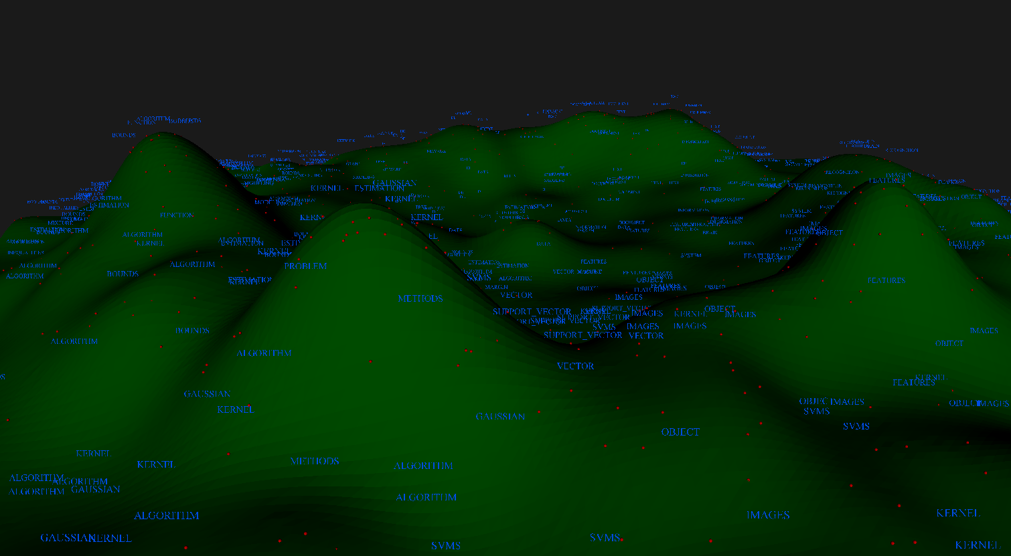
Example: Visualization of PASCAL project research topics (based on published papers abstracts)
theory
natural language processing
kernel methods
multimedia
processing

Slide 4
…typical way of doing text visualization
By having text in the sparse vector Bag-of-Words representation we usually perform so kind of clustering algorithm identify structure which is then mapped into 2D or 3D space (e.g. using MDS)
…other typical way of visualization of text is to find frequent co-occurrences of words and phrases which are visualized e.g. as graphs
Typical visualization scenarios:
  Visualization of document collections
  Visualization of search results
  Visualization of document timeline

Slide 5
Graph based visualization
The sketch of the algorithm:
  Documents are transformed into the bag-of-words sparse-vectors representation
    Words in the vectors are weighted using TFIDF
  K-Means clustering algorithm splits the documents into K groups
    Each group consists from similar documents
    Documents are compared using cosine similarity
  K groups form a graph:
    Groups are nodes in graph; similar groups are linked
    Each group is represented by characteristic keywords
  Using simulated annealing draw a graph

Slide 6
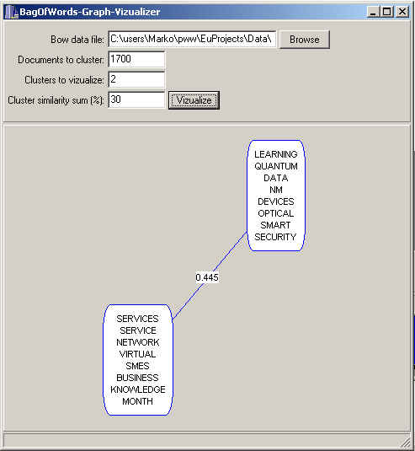
Graph based visualization of 1700 IST project descriptions into 2 groups

Slide 7
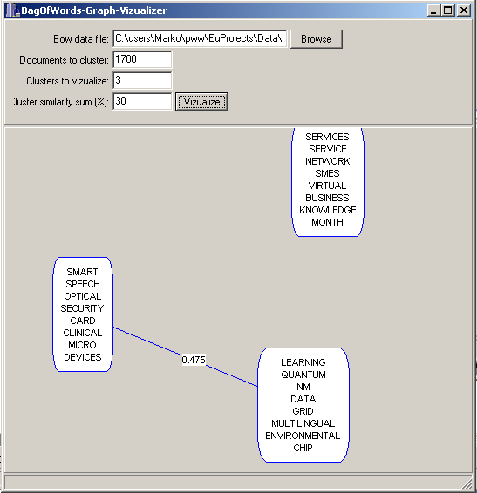
Graph based visualization of 1700 IST project descriptions into 3 groups

Slide 8
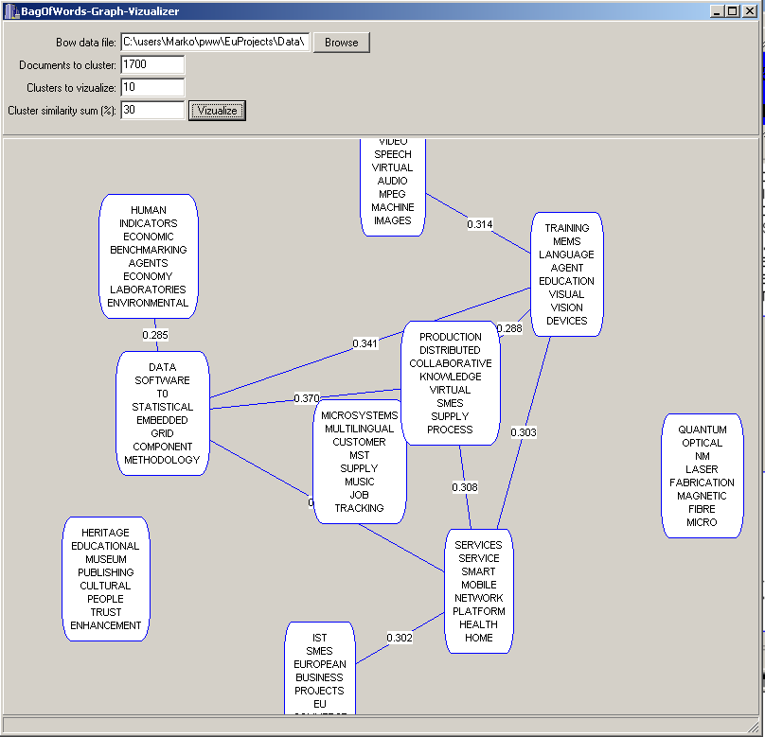
Graph based visualization of 1700 IST project descriptions into 10 groups

Slide 9
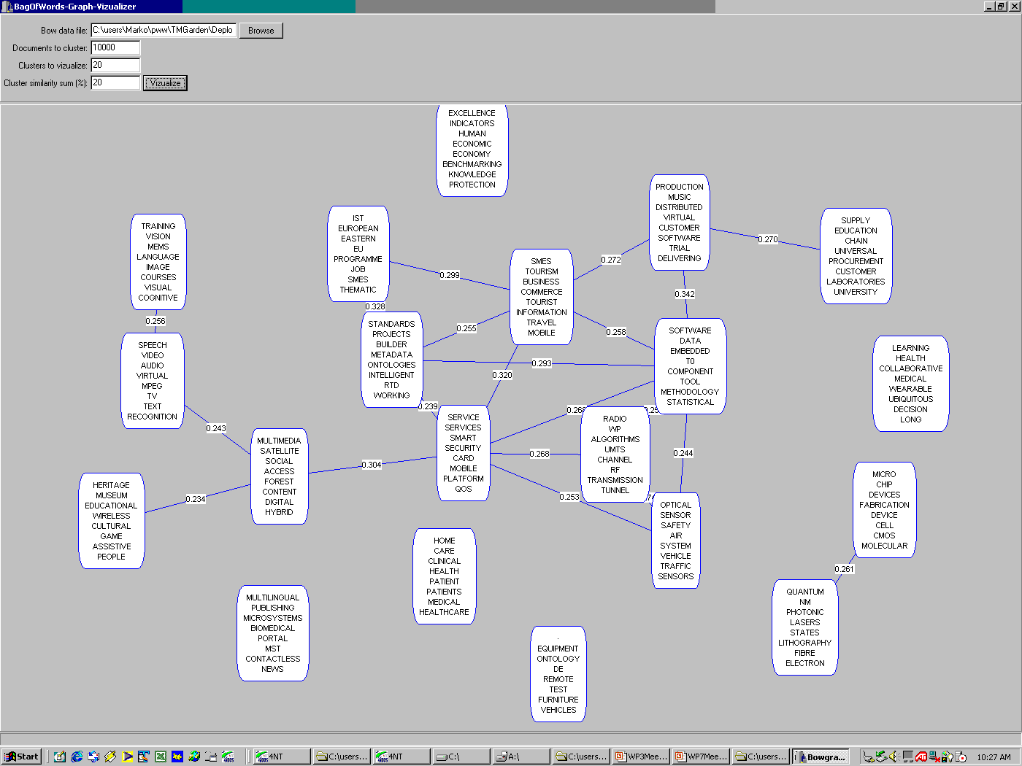
Graph based visualization of 1700 IST project descriptions into 20 groups

Slide 10
Tiling based visualization
The sketch of the algorithm:
  Documents are transformed into the bag-of-words sparse-vectors representation
    Words in the vectors are weighted using TFIDF
  Hierarchical top-down two-wise K-Means clustering algorithm builds a hierarchy of clusters
    The hierarchy is an artificial equivalent of hierarchical subject index (Yahoo like)
  The leaf nodes of the hierarchy (bottom level) are used to visualize the documents
    Each leaf is represented by characteristic keywords
    Each hierarchical binary split splits recursively the rectangular area into two sub-areas

Slide 11
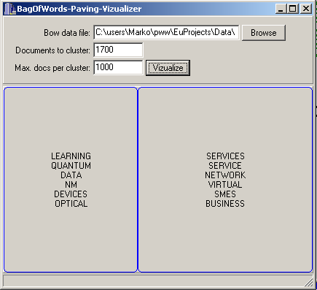
Tiling based visualization of 1700 IST project descriptions into 2 groups

Slide 12
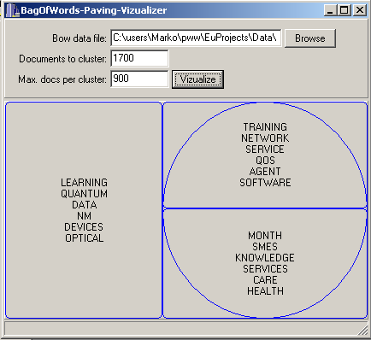
Tiling based visualization of 1700 IST project descriptions into 3 groups

Slide 13
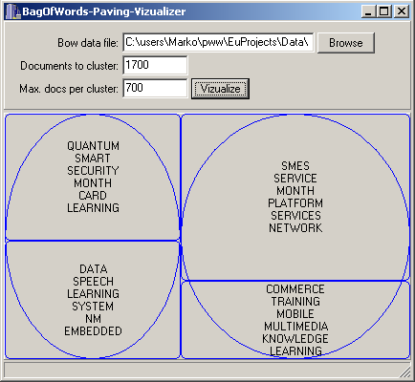
Tiling based visualization of 1700 IST project descriptions into 4 groups

Slide 14
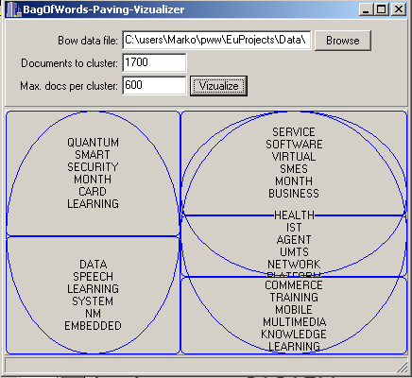
Tiling based visualization of 1700 IST project descriptions into 5 groups

Slide 15
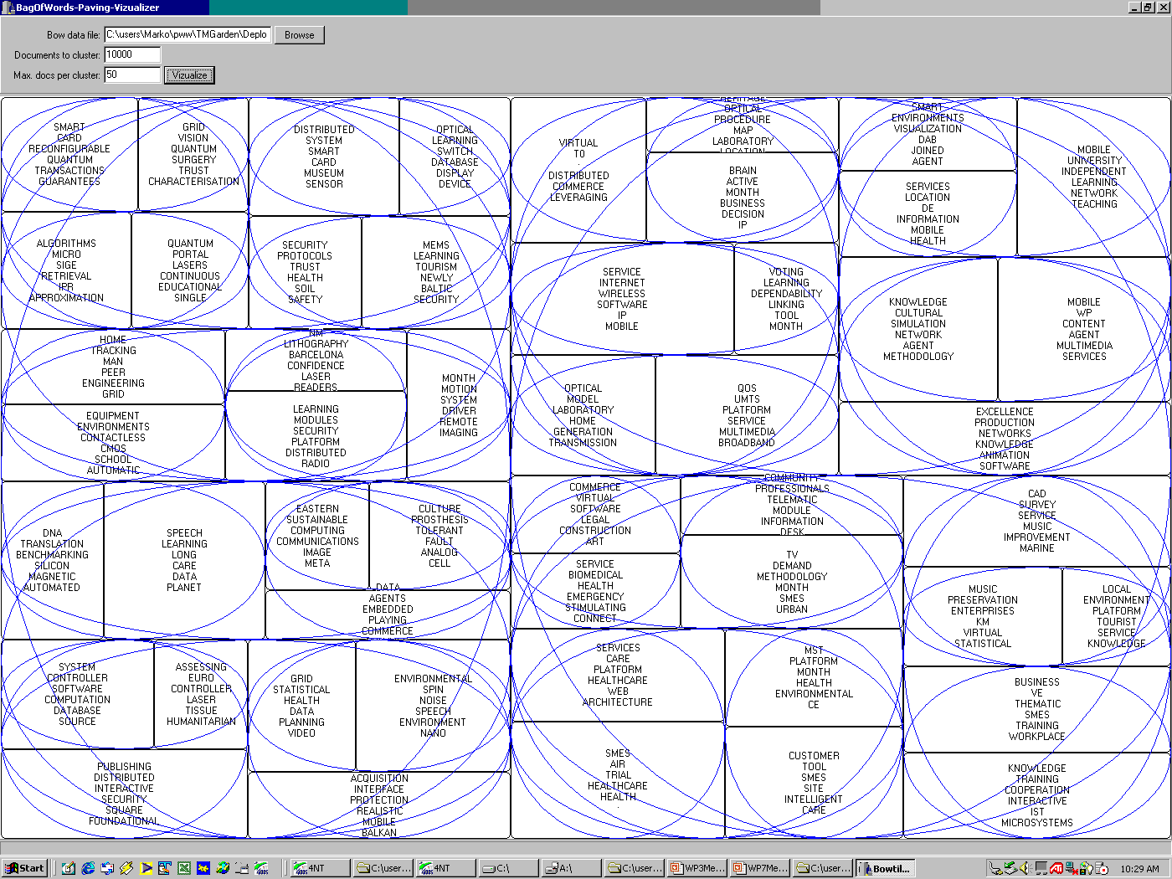
Tiling visualization (up to 50 documents per group)
of 1700 IST project descriptions (60 groups)

Slide 16
WebSOM
Self-Organizing Maps for Internet Exploration
  …algorithm that automatically organizes the documents onto a two-dimensional grid so that related documents appear close to each other
  … based on Kohonen’s Self-Organizing Maps
  Demo at http://websom.hut.fi/websom/
Self-Organizing Maps for Internet Exploration
  …algorithm that automatically organizes the documents onto a two-dimensional grid so that related documents appear close to each other
  … based on Kohonen’s Self-Organizing Maps
  Demo at http://websom.hut.fi/websom/

Slide 17
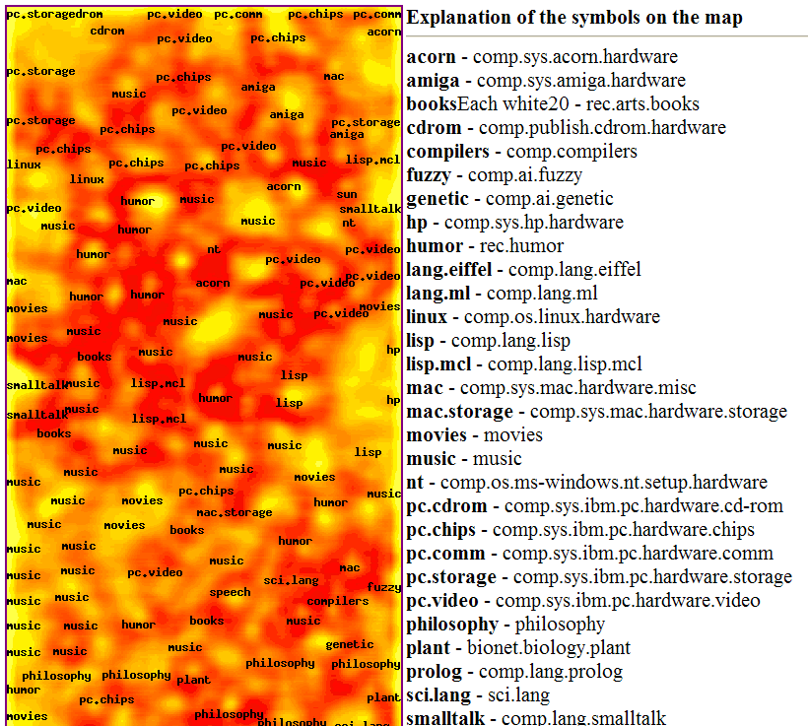
WebSOM visualization

Slide 18
ThemeScape
Graphically displays images based on word similarities and themes in text
Themes within the document spaces appear on the computer screen as a relief map of natural terrain
  The mountains in indicate where themes are dominant - valleys indicate weak themes
  Themes close in content will be close visually based on the many relationships within the text spaces
  Algorithm is based on K-means clustering
http://www.pnl.gov/infoviz/technologies.html

Slide 19
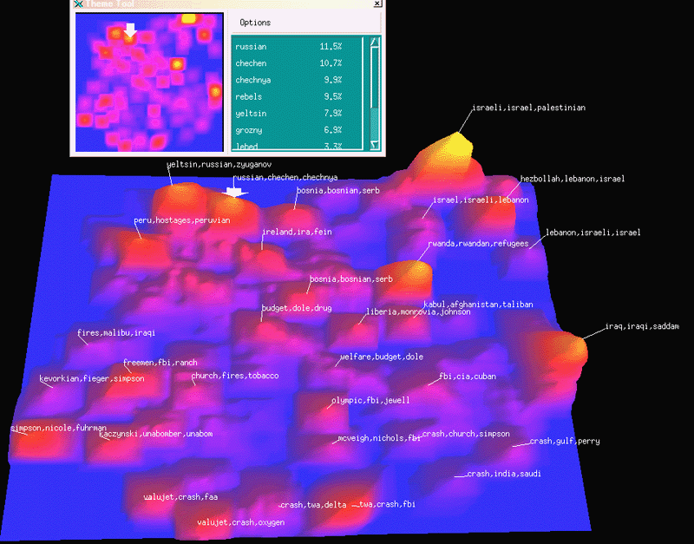
ThemeScape Document visualization

Slide 20
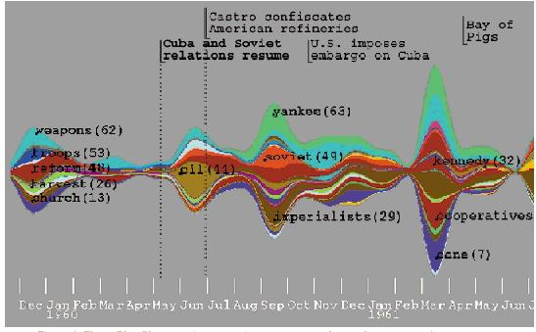
ThemeRiver topic stream visualization
The ThemeRiver visualization helps users identify time-related patterns, trends, and relationships across a large collection of documents.
The themes in the collection are represented by a "river" that flows left to right through time.
The theme currents narrow or widen to indicate changes in individual theme strength at any point in time.
http://www.pnl.gov/infoviz/technologies.html

Slide 21
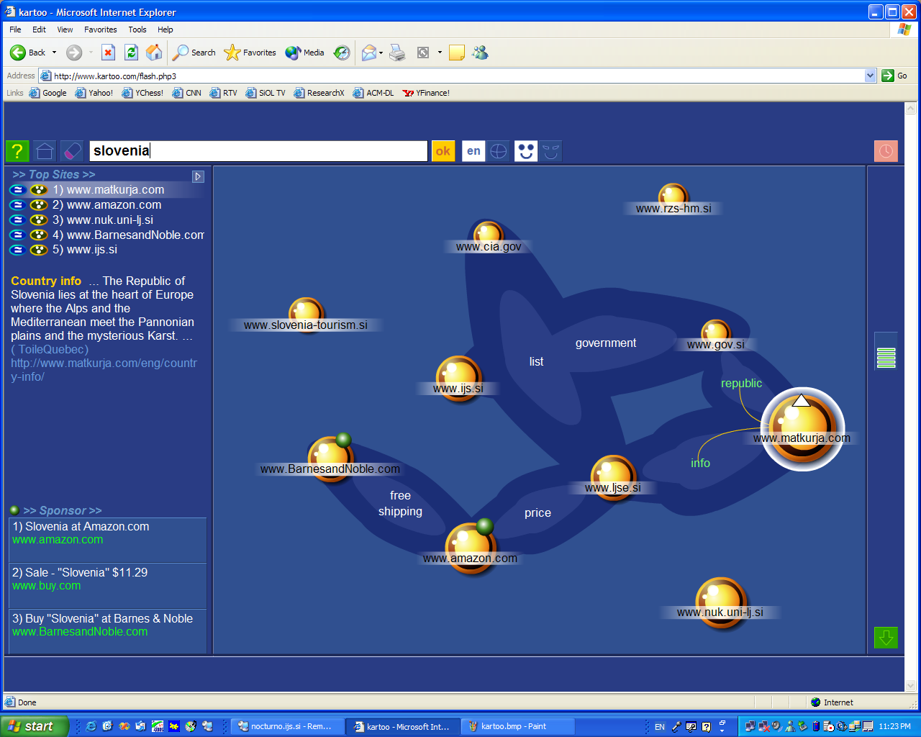
Kartoo.com – visualization of search results
http://kartoo.com/

Slide 22
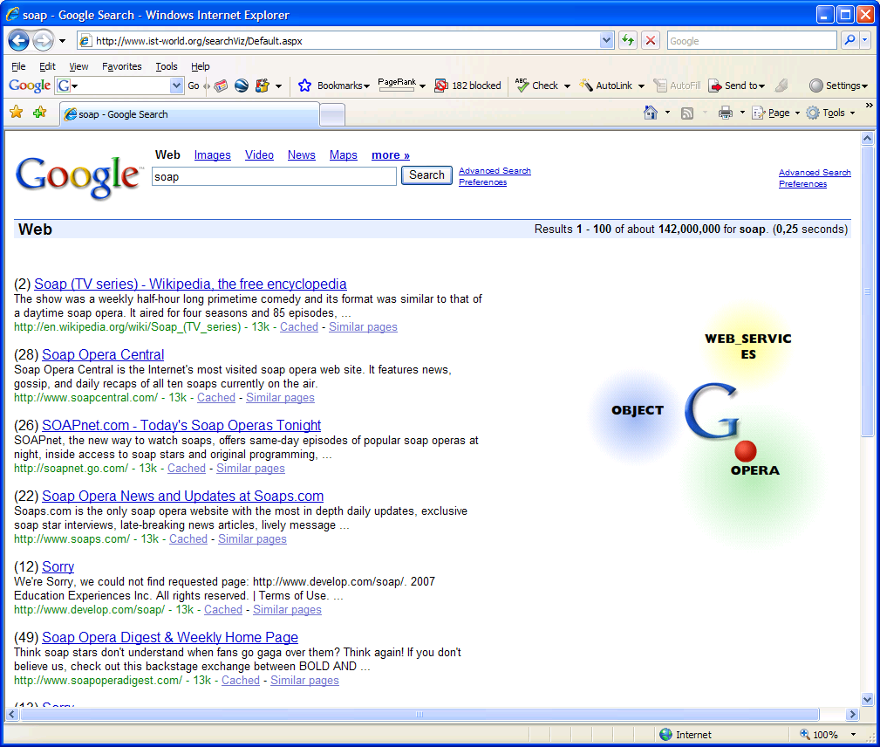
SearchPoint – re-ranking of search results

Slide 23
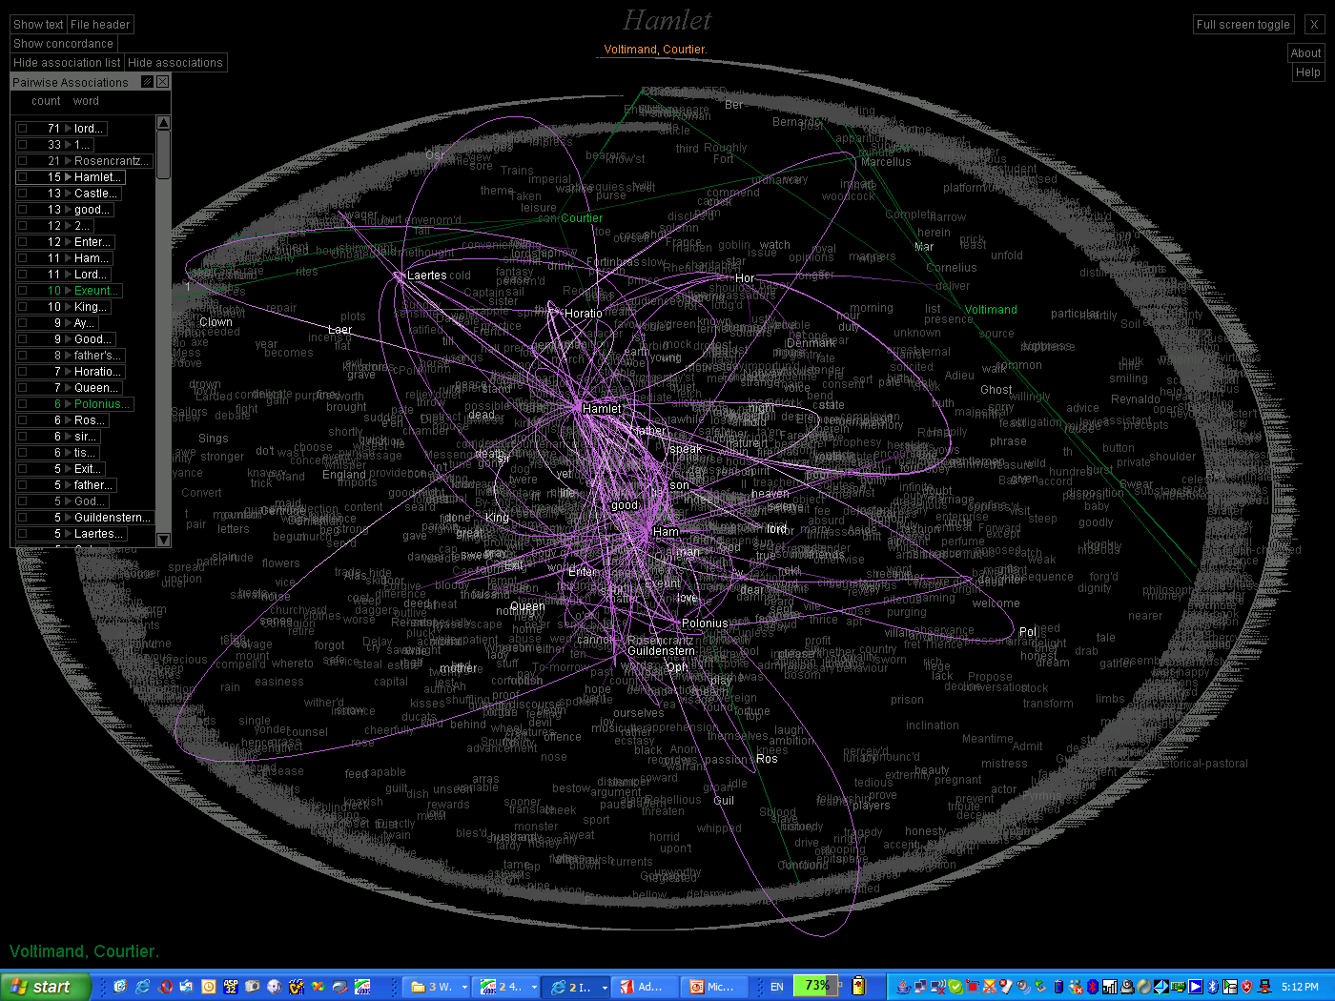
TextArc – visualization of word occurrences
http://www.textarc.org/

Slide 24
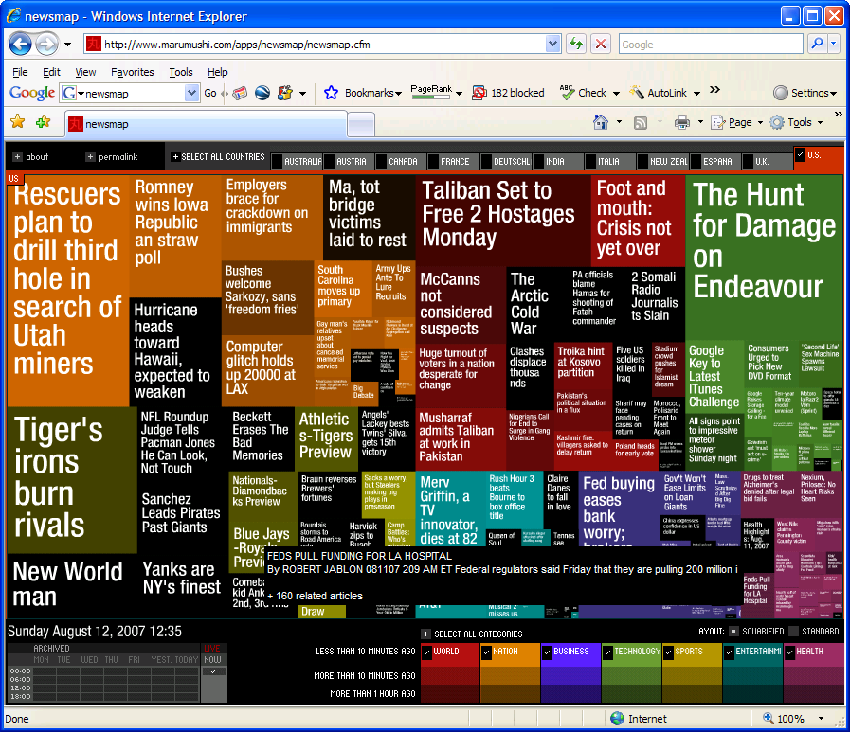
NewsMap – visualization of news articles
http://www.marumushi.com/apps/newsmap/newsmap.cfm

Slide 25
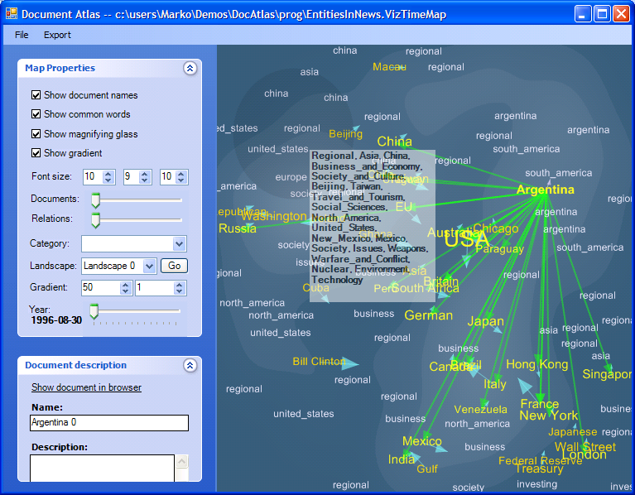
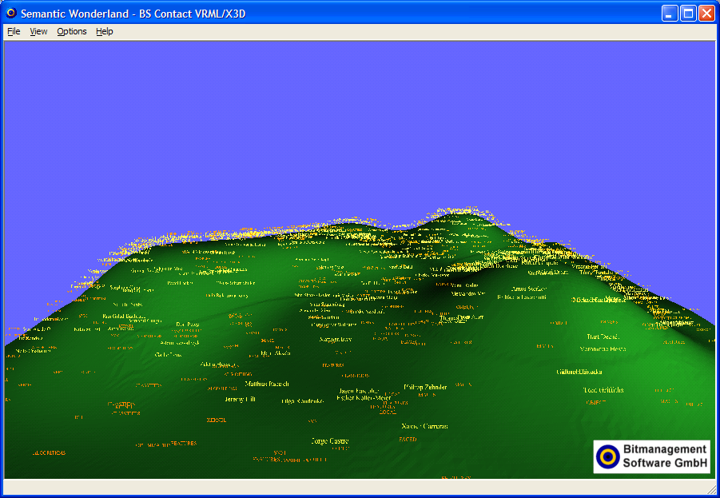
Document Atlas – visualization of document collections and their structure
http://docatlas.ijs.si

